Slide 2
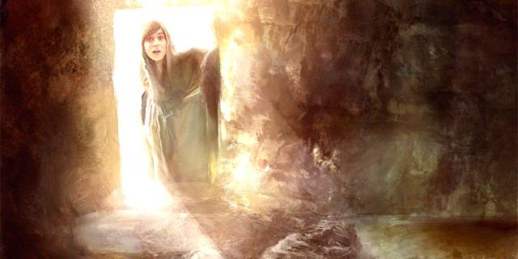
Universal Experience: Dead things stay dead.
Revealed Truth:
When God intervenes,
dead things live.

Slide 3
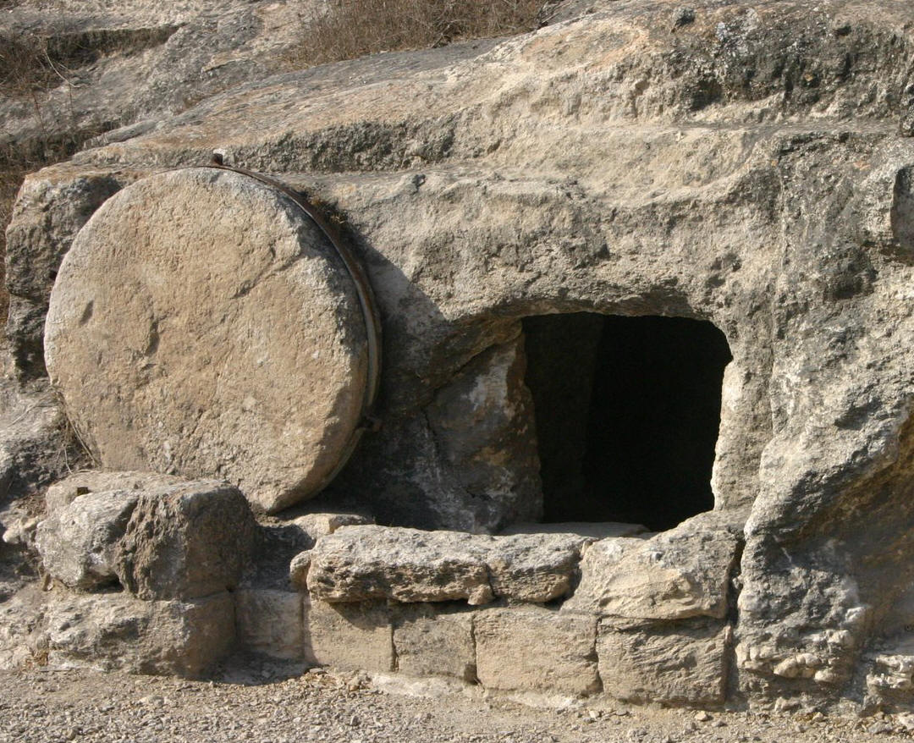
A Fundamental Tenet of Faith: God Has the Power to Restore Life

Slide 4
How the Resurrection Transformed the Disciples

Slide 5
How the Resurrection Can Transform You
Justifying faith is grounded upon the conviction that God raised Jesus from the dead.

Slide 6
How the Resurrection Can Transform You
Justifying faith accepts that God can restore anyone to spiritual life.

Slide 7
How the Resurrection Can Transform You
Such belief and transformation assure me of resurrection to eternal life.

Slide 8
If you reject the resurrection of Christ, what is the basis of your hope for life beyond death?

