Slide 2
Galatians 2:20

I have been crucified with Christ; it is no longer I who live, but Christ lives in me;

and the life which I now live in the flesh I live by faith in the Son of God,

who loved me and gave Himself for me.

Slide 3
As Death Nears …
Pain management
Privacy, dignity
Comfort of loved ones
Words of affirmation

Slide 4
The Cross
Pain management?
Privacy, dignity?
Comfort of loved ones?
Words of affirmation?

Slide 5
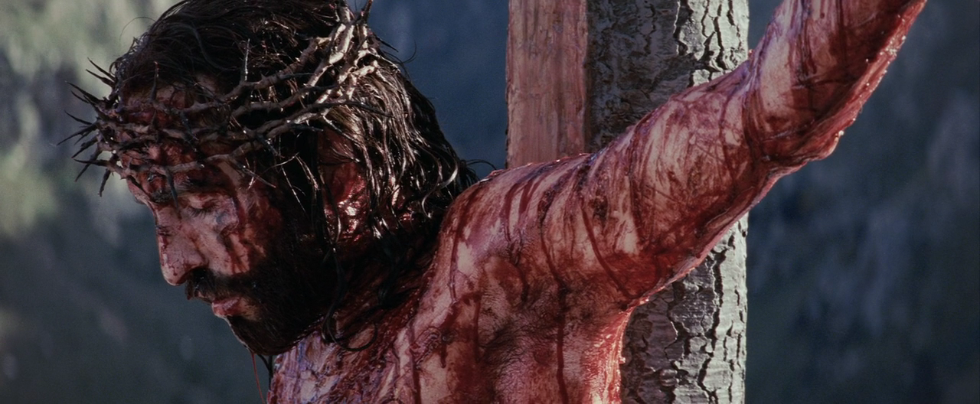
Truly this man was the Son of God!
Jesus suffered this for me!

Slide 6
Galatians 2:20

I have been crucified with Christ; it is no longer I who live, but Christ lives in me;

and the life which I now live in the flesh I live by faith in the Son of God,

who loved me and gave Himself for me.

Slide 7
Truly this man was the Son of God!
Jesus suffered this for me!
Where sorrow and hope converge.

