Slide 2
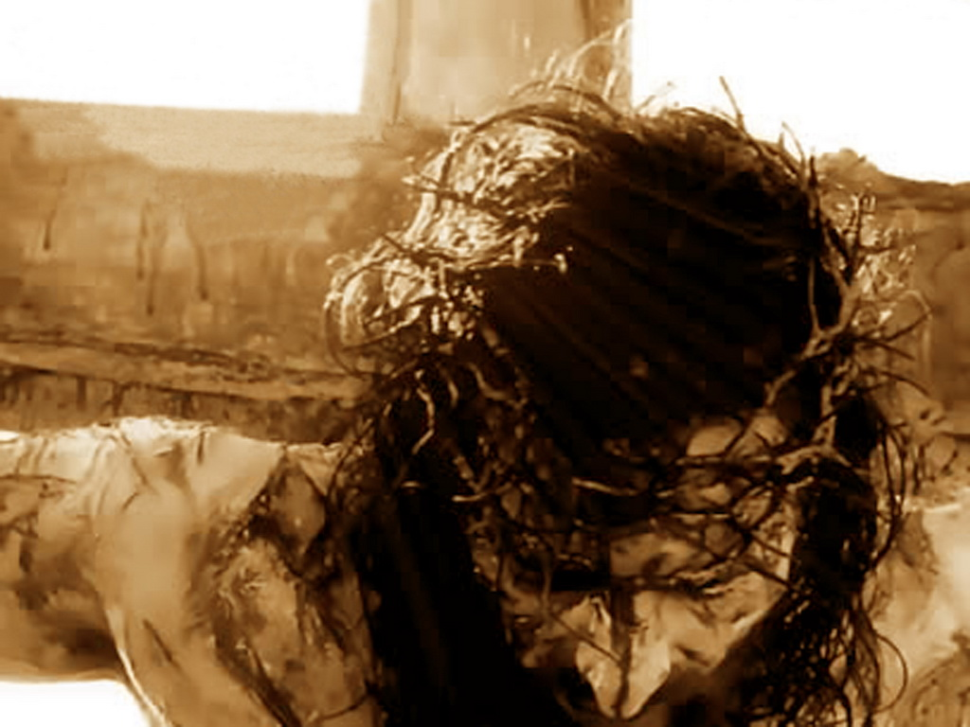
What Does the Cross
Have to Do … with Me?
All are guilty of sin … including me.
The penalty of death applies to all … including me.
Jesus died for the sins of all … including me.

Slide 3
The Cross: Skeptics and Unbelievers
A stumbling block to Jews.
Foolishness to Gentiles.

Slide 4
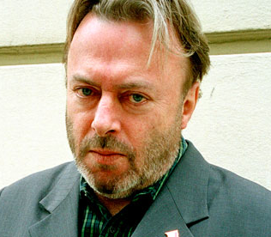
The Cross: Skeptics and Unbelievers
Christopher Hitchens
“The concept of vicarious redemption is the most repulsive, I think ... the idea that by throwing your sins onto somebody else and to escape that – you can have them annulled, abolished – that is a disgusting and immoral doctrine. If I care for you enough, I can pay your debt even if you incurred it out of your own stupid irresponsibility.

Slide 5
The Cross: Skeptics and Unbelievers
Christopher Hitchens
“I could if I wished … offer to take your place in prison … or if you were hostage I could do that if I loved you enough, and there are examples of people willing to put themselves forward as the substitute for someone’s execution … But you cannot relieve people of their responsibility, and it’s immoral to offer to do so. It would be disgusting if it could be done.

Slide 6
The Cross: Skeptics and Unbelievers
Christopher Hitchens
“So, the moral rot of Christianity is exposed in its central doctrine of vicarious forgiveness. It’s an abdication of moral responsibility … We would be so much better off without this cult. We would think so much more clearly about the real moral questions that confront us.”

Slide 7
But Why a Suffering Savior?
The ultimate example of obedience – no matter what.
Qualification as our high priest.
True nature of sin exposed.

