Slide 2
For He crushes me with a tempest, and multiplies my wounds without cause.
It is all one thing; therefore I say, “He destroys the blameless and the wicked.”
Job 9:17, 22

Slide 3
Does it seem good to You that You should oppress, that You should despise the work of your hands …
That you should seek for my iniquity and search out my sin,
Although You know that I am not wicked …?
Job 10:3, 6-7

Slide 4
He tears me in His wrath, and hates me; He gnashes at me with His teeth …
I was at ease, but He has shattered me; He also has taken me by my neck, and shaken me to pieces …
He breaks me with wound upon wound.
Job 16:9, 12, 14

Slide 5
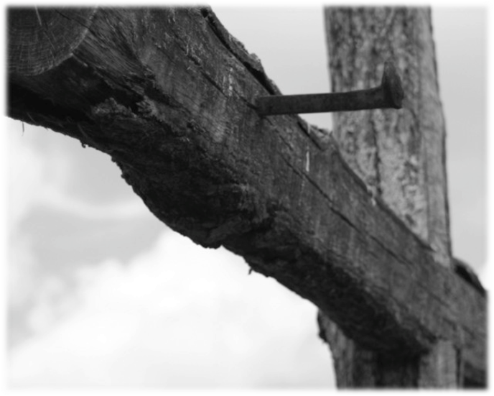
Why doesn’t God do something?!
This isn’t fair!
If God really loved me He would …

Slide 6
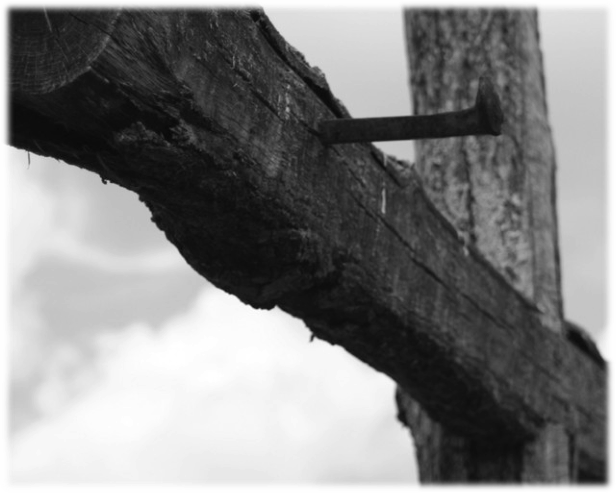
“For God so loved the world that He gave His only begotten Son.”
John 3:16

Slide 7
“Greater love has no one than this, than to lay down one’s life for his friends.”
John 15:13

Slide 8
“By this we know love, because He laid down His life for us.”
1 John 3:16

Slide 9
What Job Couldn’t Reconcile
That God still cared about him.
That God still had
confidence in him.
That God’s silence wasn’t abandonment.

