Slide 2
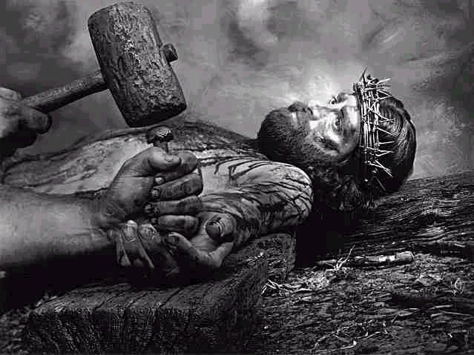
“Father, forgive them, for they do not know what they do.”
How difficult is it for us to utter the same words?

Slide 3
The Challenge of Offering Forgiveness
The one phrase in His sample prayer that Jesus highlights.

Slide 4
The Challenge of Offering Forgiveness
The one phrase in His sample prayer that Jesus highlights.
Peter questions how often one must forgive.

Slide 5
The Challenge of Offering Forgiveness
Our natural tendency when wronged is to withhold forgiveness.

Slide 6
The Challenge of Offering Forgiveness
Jesus is calling us to something HIGHER.

Slide 7
The Challenge of Accepting Forgiveness
We tend to project our difficulty to forgive upon God.

Slide 8
The Challenge of Accepting Forgiveness
“My sin is too bad.
I don’t deserve forgiveness.”

Slide 9
The Challenge of Accepting Forgiveness
No matter what you’ve done, God still has a purpose for you.

Slide 10
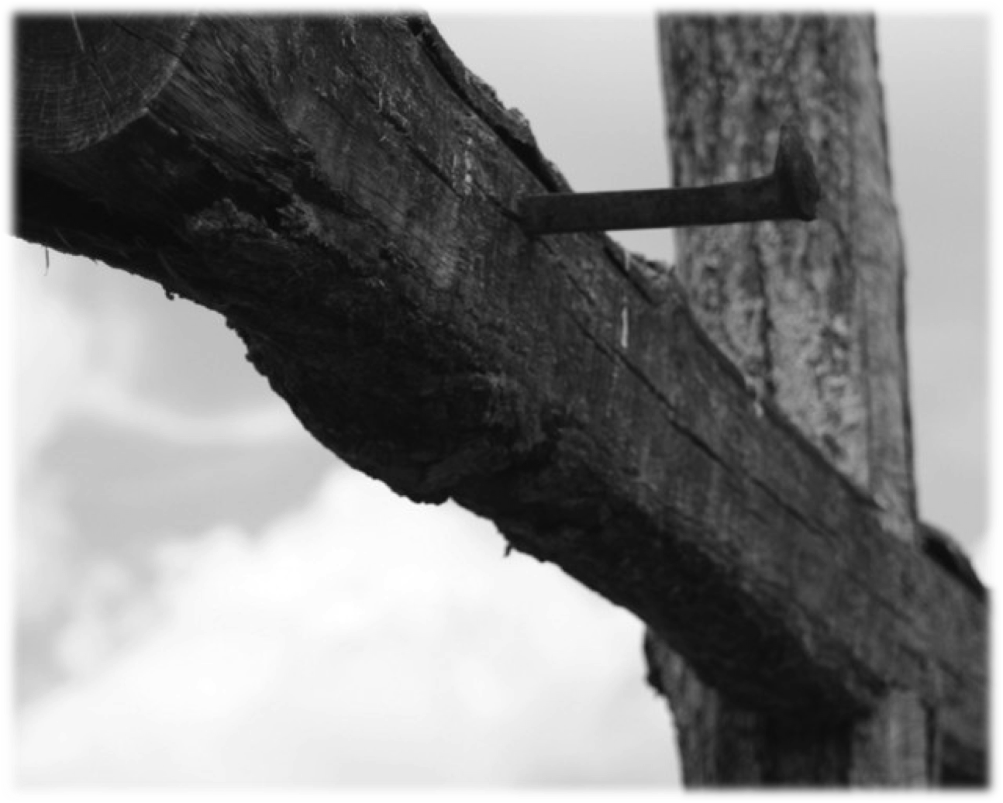
Galatians 2:20

I have been crucified with Christ; it is no longer I who live, but Christ lives in me;

and the life which I now live in the flesh I live by faith in the Son of God,

who loved me and gave Himself for me.

