Slide 2
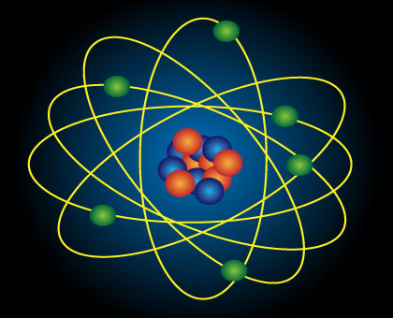
An Atom?

Slide 3
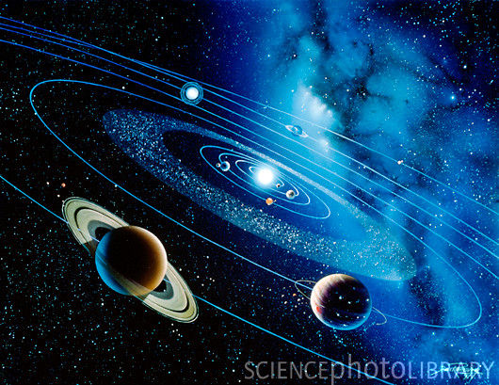
Gravitational Force of the Sun?

Slide 4
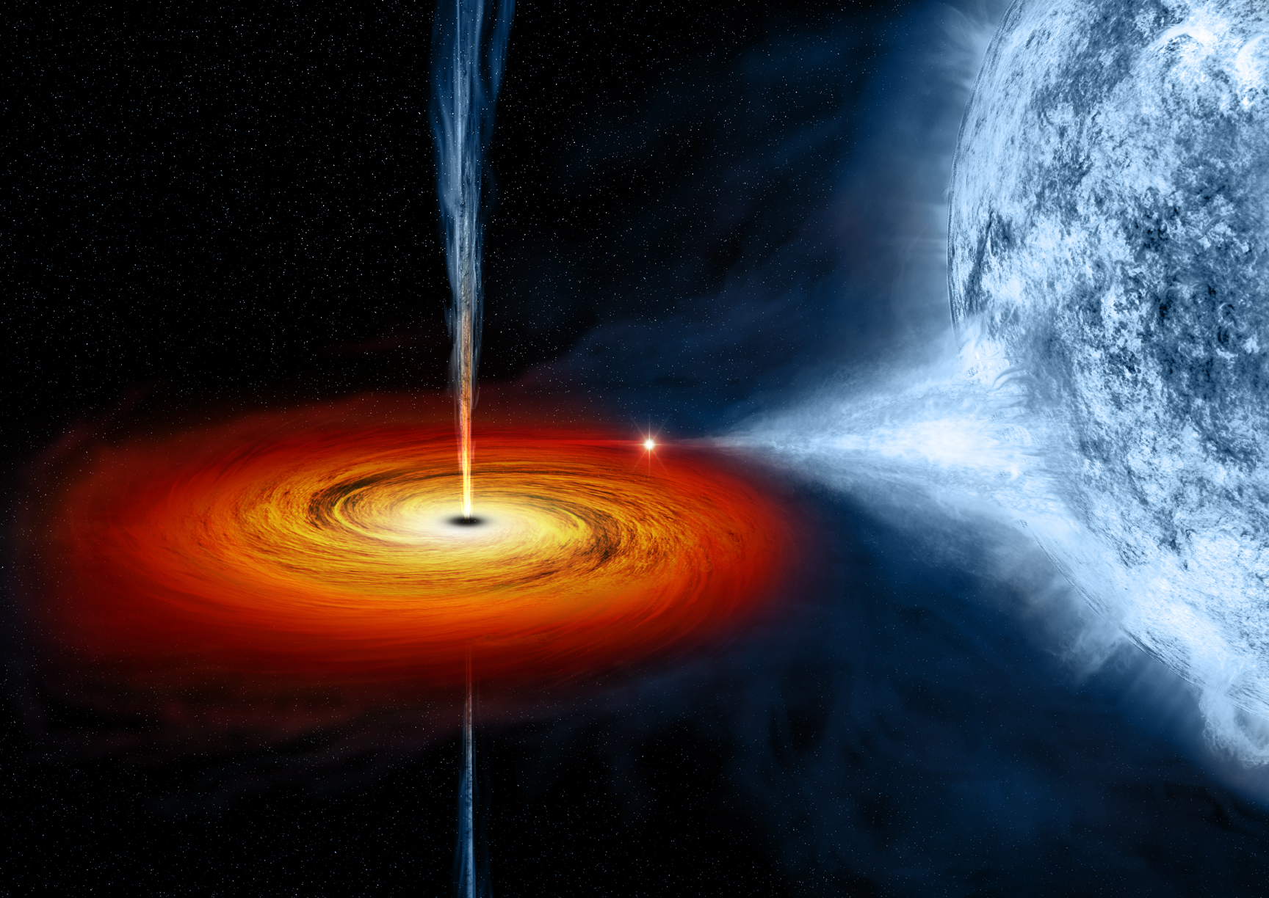
A Black Hole?

Slide 5
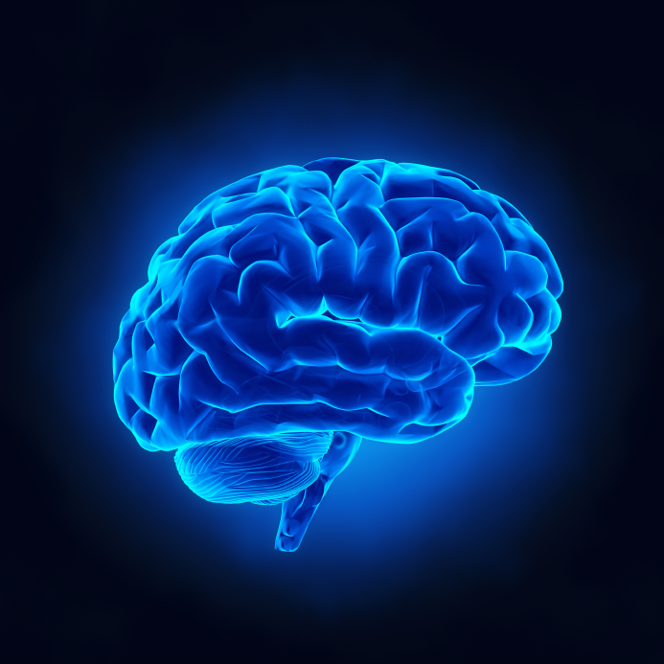
SELFWILL
The power to determine our own actions.

Slide 6
SELF WILL
Selfishness: Human will that has removed its focus from God and enthroned its own interests.

Slide 7
SELF WILL
“You are not mindful of the things of God, but the things of men.”
Matthew 16:23

Slide 8
“If anyone desires to come after Me, let him ...”
SELF WILL
Deny himself.
Take up his cross.
Follow Me.

Slide 9
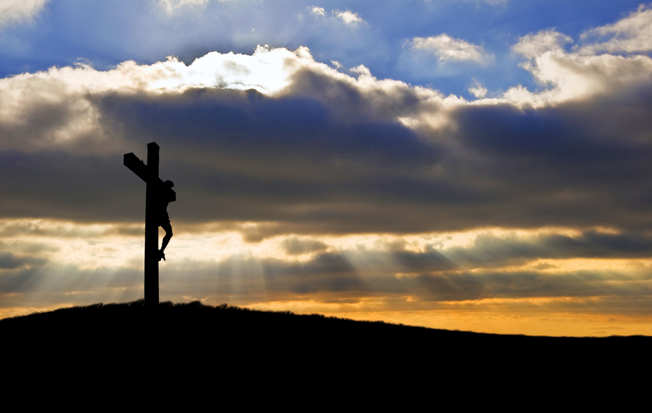
And He died for all, that those who live should live no longer for themselves, but for Him who died for them
and rose again.
2 Corinthians 5:15

Slide 10
Galatians 2:20

I have been crucified with Christ; it is no longer I who live, but Christ lives in me;

and the life which I now live in the flesh I live by faith in the Son of God,

who loved me and gave Himself for me.

